Slide 1

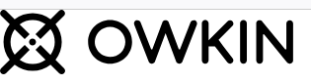
Abstra Weekly Support
Weekly Update and Process Improvements

Slide 2

Agenda
Key Accomplishments
Process Improvements
Challenges and Solutions
Next Steps

Slide 3

Key Accomplishments of this week
- Resolved Zendesk auto-assignment issue, improving tickets rooting.
- Modified Zendesk forms with custom fields for better usability and API integration.
- Set up Zendesk - Slack integrations for feedback notifications.
- Developed a Python script for generating customized Zendesk reports.
- Started setup: AWS-Zendesk integration with webhook.

Slide 4
Process Improvements
- Delete inactive API keys in Zendesk for enhanced security.
- Implement Knowledge Base (KB) documentation for all solutions - Zendesk.
- Automate feedback synchronization in Canny using Autopilot.

Slide 5

Challenges and Solutions
- Challenge: Users may struggle with AWS form fields.
Solution: Simplify form design and auto-populate technical fields.
- Challenge: Manual ticket synchronization in Canny from Zendesk.
Solution: Plan for automation with Canny Autopilot.

Slide 6

Zendesk – AWS integration
Ticket Creation Process in Zendesk
User-Facing Form:
Users fill out a simplified form in Zendesk with the following fields:
Subject (AWS field: subject)
Description (AWS field: communicationBody)
Severity (AWS field: severityCode): Dropdown options like Low, Medium, High.
Issue Type (AWS field: issueType): Dropdown options like Bug, Configuration Issue, Support Request, etc.
Language (AWS field: language): Dropdown options like en-US, fr-FR, etc.
Automatic Technical Field Population:
serviceCode (always set to "SageMaker"), categoryCode (set to a specific category related to SageMaker issues), and region (set to a fixed value like "us-east-1") are automatically populated by the backend system (Lambda function).

Slide 7

Zendesk – AWS integration
Data Transmission to AWS
EventBridge and Lambda Integration:
When a ticket is submitted in Zendesk, the data is sent to EventBridge, which then triggers the Lambda function.
Lambda function processes the data and automatically fills in the required technical fields such as serviceCode, categoryCode, and region.
The completed ticket is forwarded to the AWS Support API to create a case.
AWS Support Case Creation:
The AWS Support API receives the ticket and creates a case in the AWS system with all the required information, including the technical fields that were auto-filled.

Slide 8
Zendesk – AWS integration
AWS Requirements and Setup
IAM Role and Permissions:
A dedicated IAM role is required to grant permissions for interacting with the AWS Support API and Lambda execution.
The role must include:
aws-support:CreateCase: To create support tickets.
aws-support:DescribeServices: To get service information for categorization.
Lambda Execution Permissions: For Lambda to execute and interact with CloudWatch for logs.
Lambda Function:
Lambda function processes the ticket data, automatically populates the technical fields, and forwards the processed ticket to AWS Support API.
The Lambda function ensures that the ticket has all required information, even though the user only fills in the basic form.
EventBridge Setup:
EventBridge will listen for events from Zendesk and trigger the Lambda function to process the data, ensuring the automated flow from Zendesk to AWS.

Slide 9
Zendesk – AWS integration
User Experience and No AWS Account Required
No AWS Account Needed:
Users do not need an AWS account to create tickets or communicate with AWS Support.
All ticket-related communication occurs within Zendesk, which acts as the interface between the user and AWS Support.
Automatic AWS Responses:
AWS engineers respond to tickets, and the responses are automatically sent to Zendesk, where users can see the updates.
Ticket Closure: Once the case is resolved, AWS closes the ticket, and the user is notified via Zendesk.
Users can also provide feedback on the support process.
Seamless User Interaction:
The user interacts entirely within Zendesk, with all technical details handled in the background. AWS Support interacts directly through Zendesk, making the process transparent to the end user.

Slide 10

Resolved Zendesk Tickets
1. Auto-assignment Issue (Requester: Thomas Rosnet):
Problem: Tickets were automatically assigned to the first agent who replied, causing confusion and extra manual work.
Solution: The trigger was updated to prevent tickets from being auto-assigned to the user who is also the Requester.
Why it's great: This solves cases where a user has both an Agent role and a standard user account. For example, if a user submits a ticket (as the Requester), the ticket will no longer be automatically assigned to them when they respond. This reduces confusion and improves workflow efficiency.
2. Zendesk Form Modifications (Requester: Camille Boillet):
Problem: Key fields like Dataset ID, Dataset Name, and Hyperlink were missing in Zendesk forms, making it harder to track data accurately.
Solution: The requested fields were added and implemented in the form. These fields are visible only to agents.

Slide 11

Independent Exploration ☺
While trying to analyze Richard's activities, I faced a little challenge: there was no direct way to review his tickets because his user account had been deleted from Zendesk.
However, his name appeared in ticket comments, which provided a clue, but manually going through over 1,900 tickets was simply not possible.
To address this, I wrote a Python script that use the Zendesk API to fetch all tickets from the past two months.
The script generated a table containing all relevant information, which I could then search and analyze further.
The table allowed me to:
Search tickets and find similar issues.
Identify teams and patterns in ticket assignments.
Analyze Richard's comments to understand his approach to problem-solving.
Why this script can be useful going forward:
It enables the creation of custom reports from Zendesk in a structured table format, making all key data easily accessible in one place.
It provides access to data that isn’t otherwise available through the Zendesk interface or tools like FullStory. For example, we can retrieve tickets linked to deleted users, see their comments, and access other critical details.
This opens up opportunities for deeper analysis, trend identification, and easier grouping of similar issues to improve ticket resolution processes.
Outcome: This script helped me build a better understanding of the support processes and ticket resolution strategies, which will significantly accelerated my onboarding and I believe improve my efficiency.

Slide 12

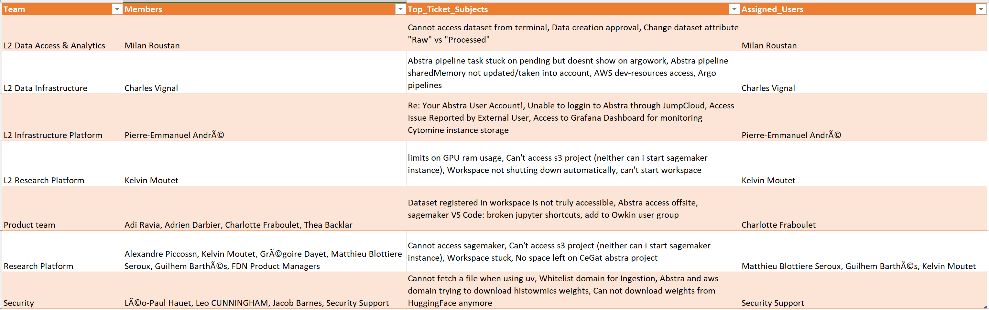
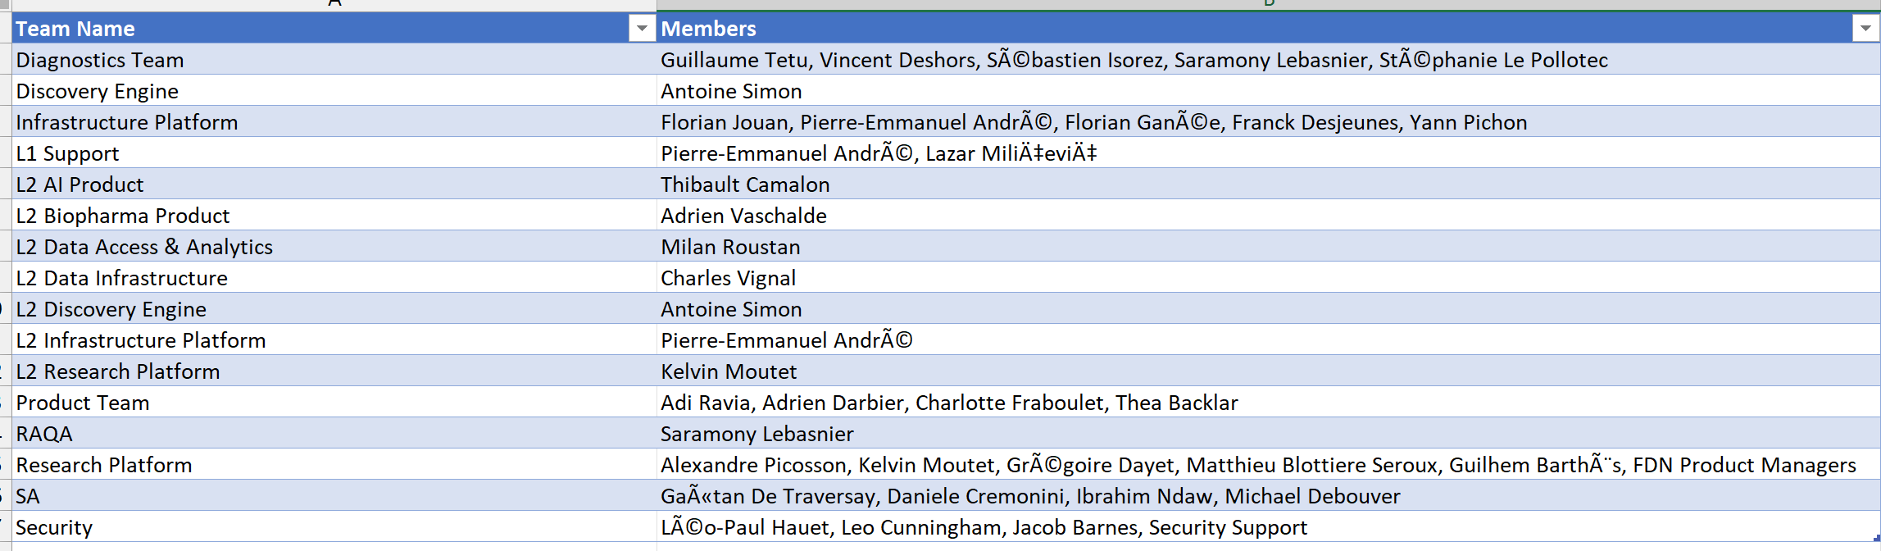
Some examples of tables ☺

Slide 13
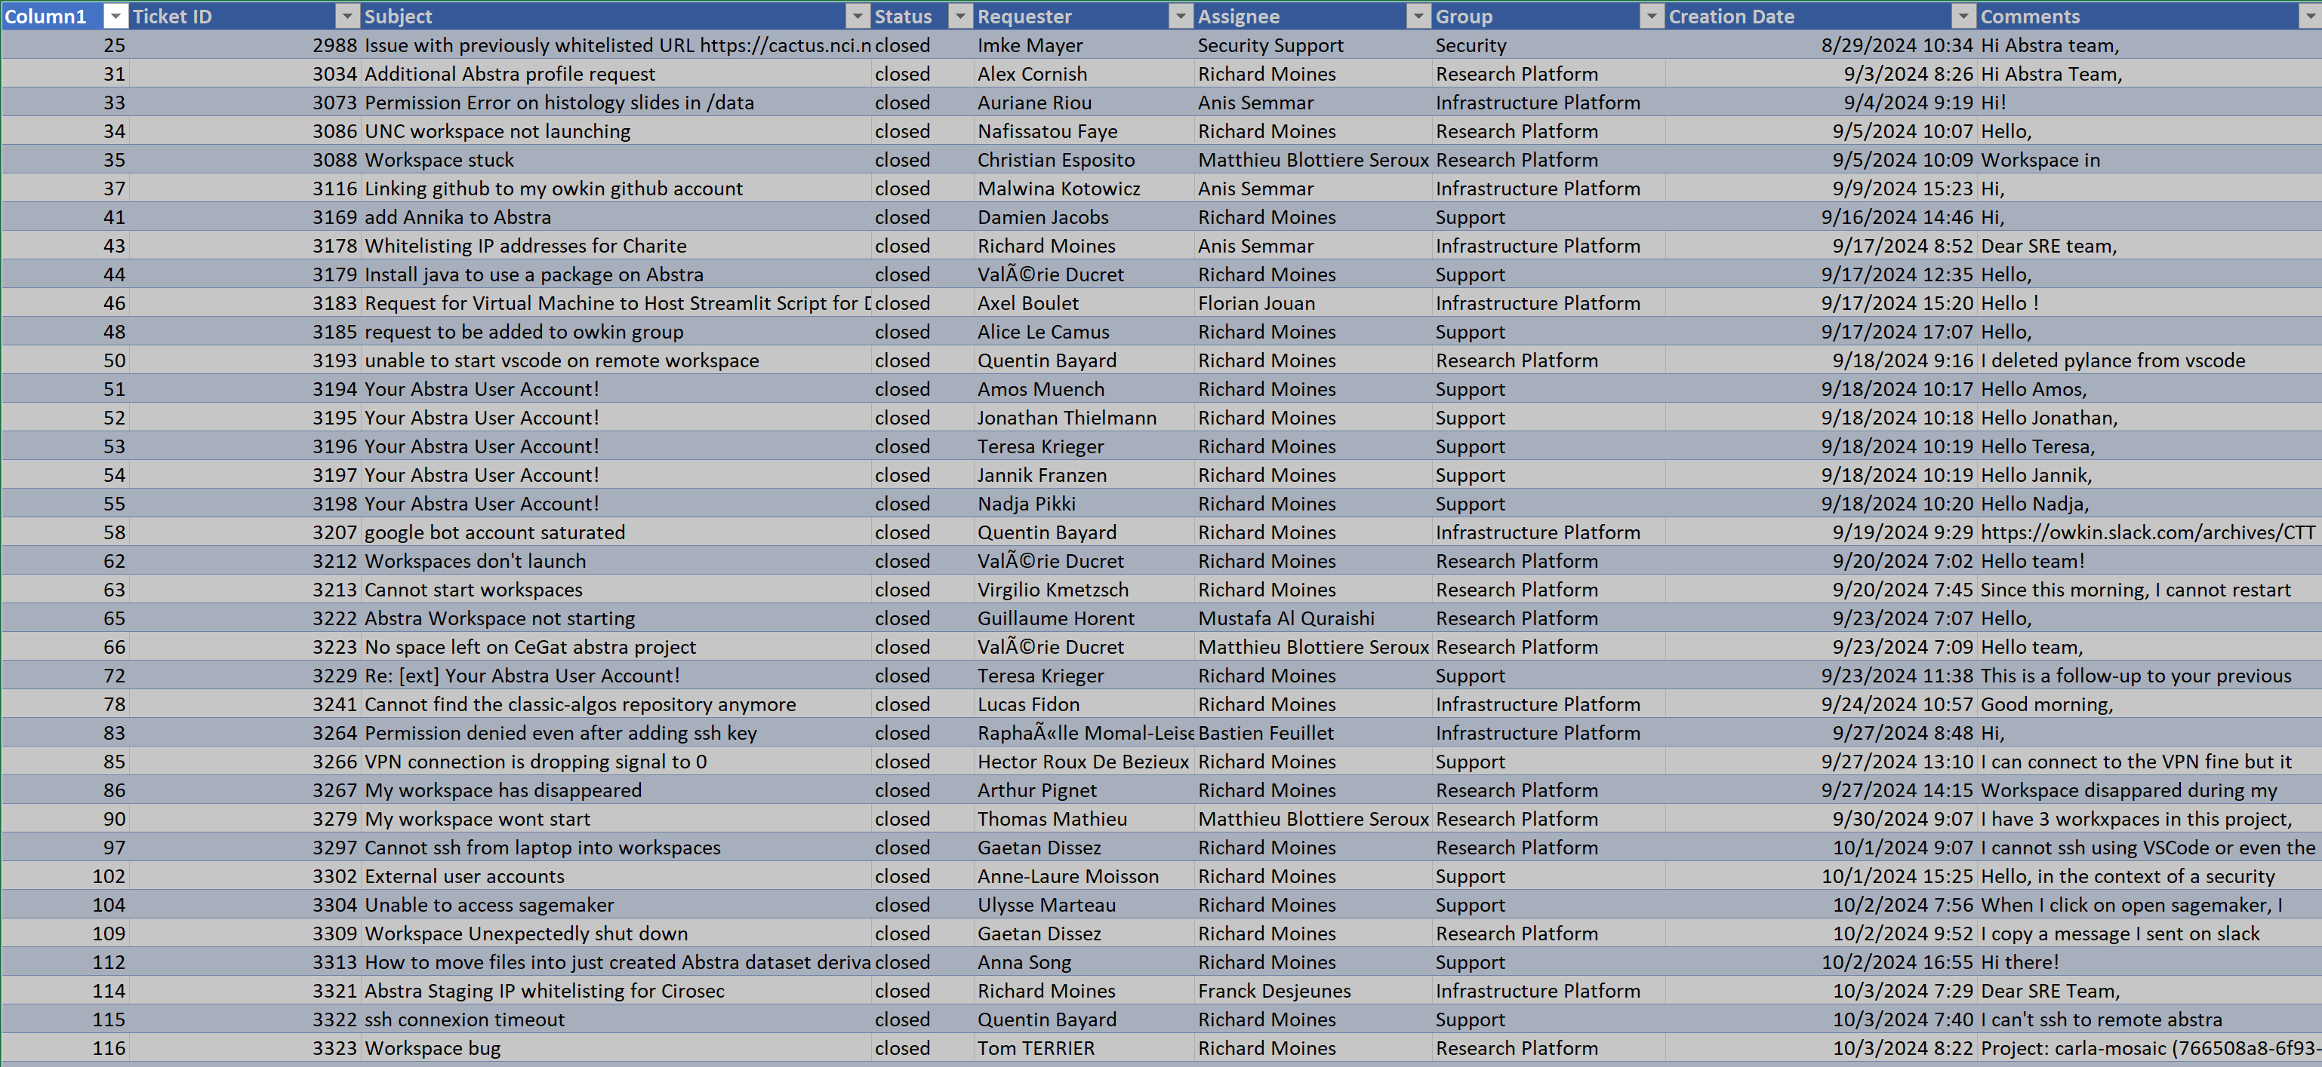
Some examples of tables ☺

Slide 14
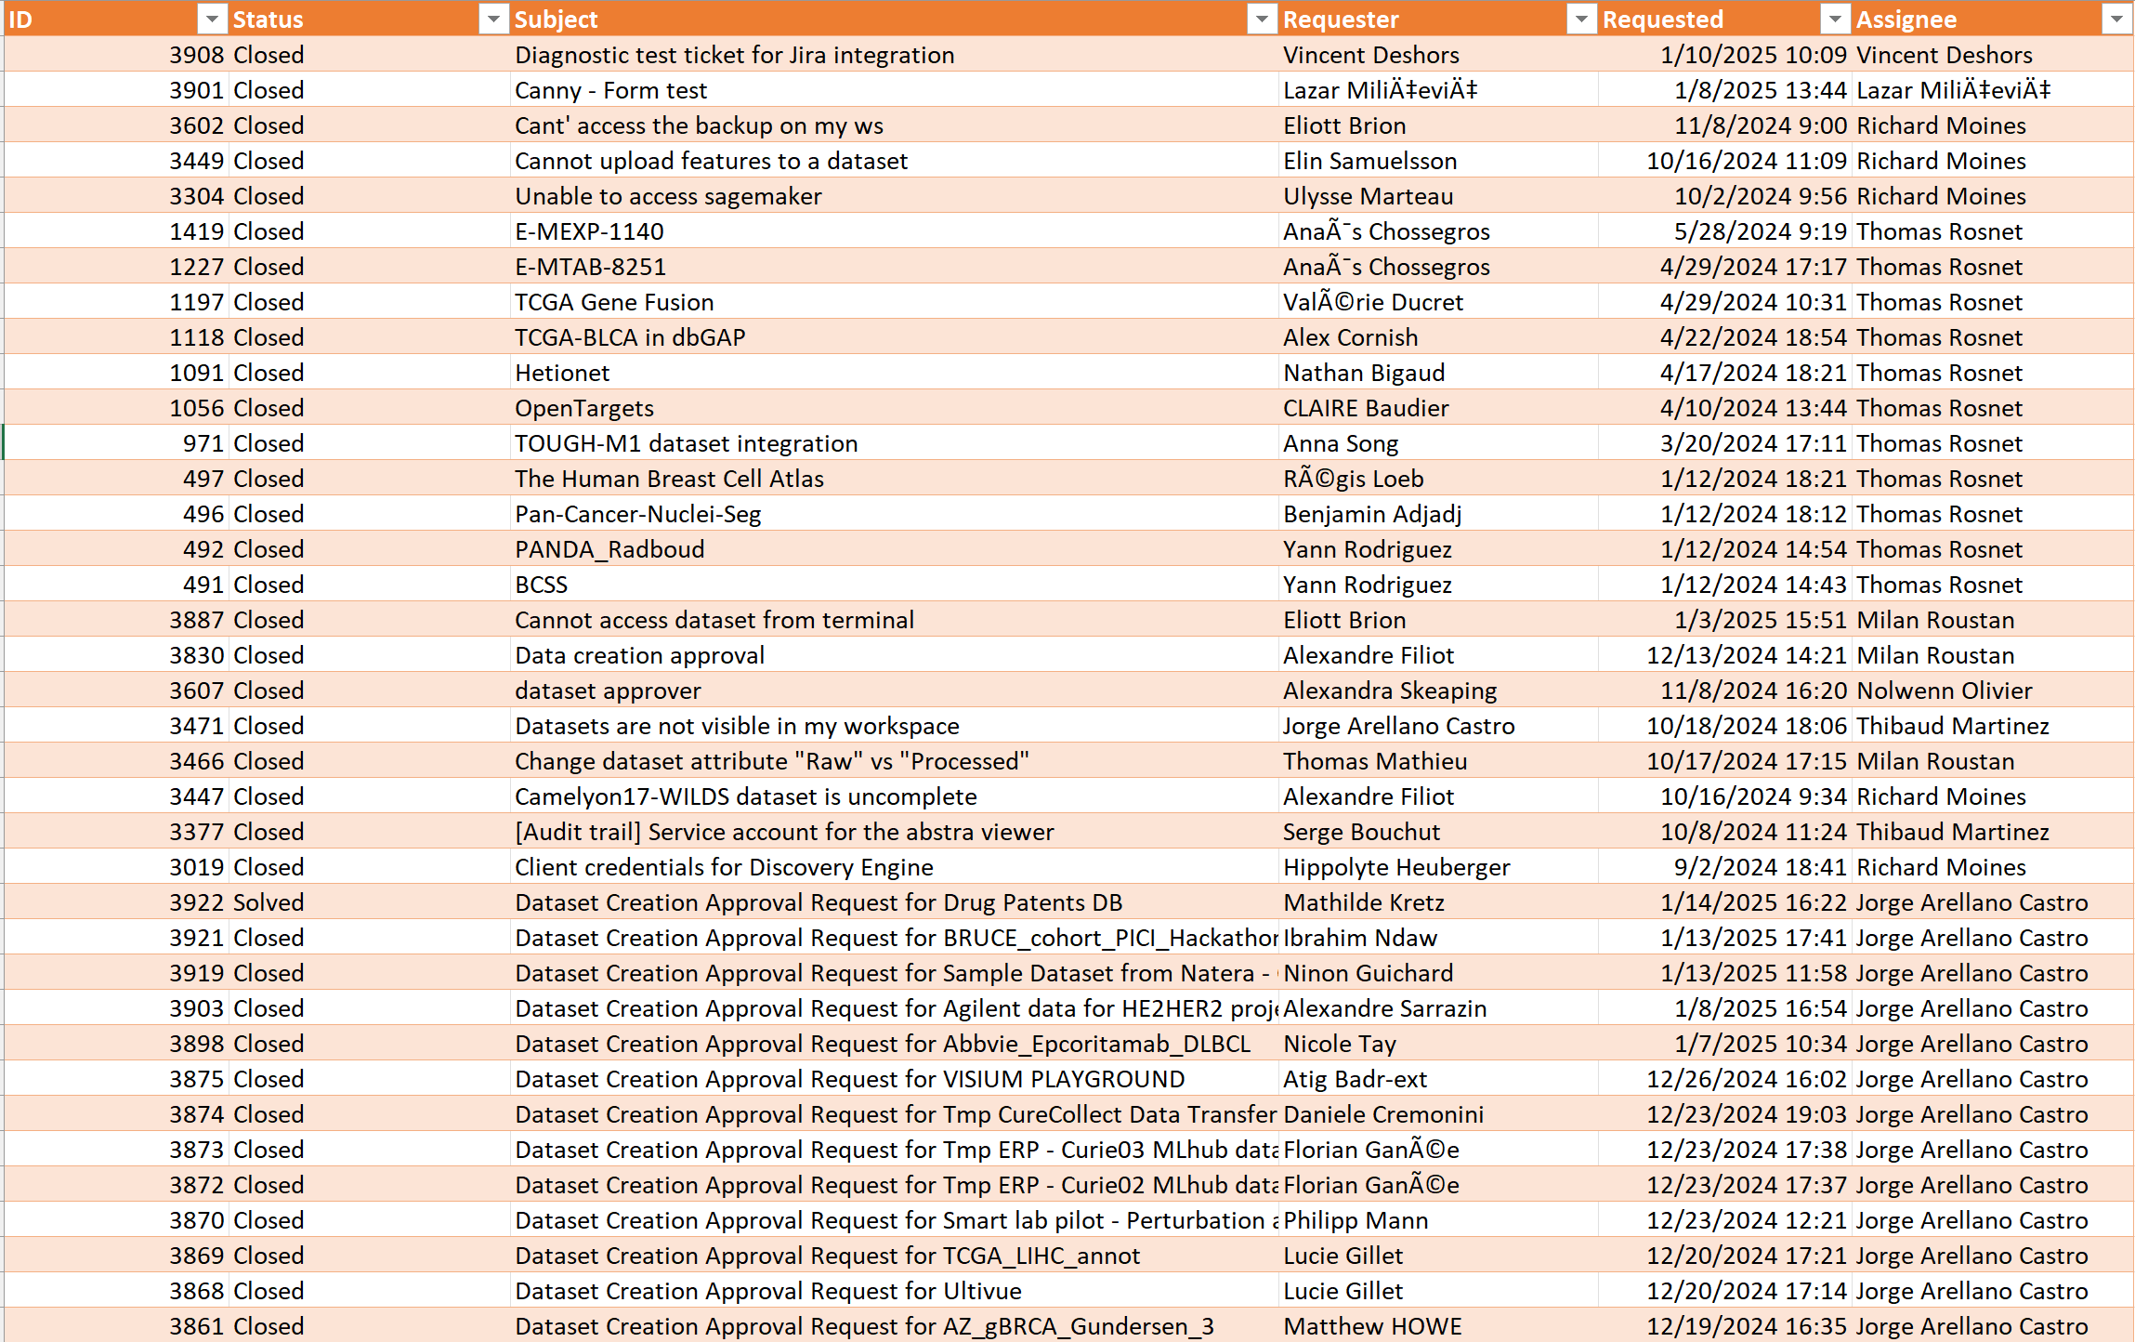
Some examples of tables ☺

Slide 15

Next Steps
1. Finalize AWS-Zendesk form design.
2. Collaborate with AWS for during the test phase to make improvements.
3. Monitor feedback processes for further automation.
4. Create detailed Notion articles for documented solutions.

Slide 16

Thank you! ☺
Thank you for taking your time to watch what is probably the most boring presentation you have seen so far. 😄
If you have any questions, please feel free to ask! 😊

